Slide 1
RUNGTA COLLEGE OF DENTAL SCIENCES & RESEARCH
COMPLEMENT SYSTEM
DEPARTMENT OF MICROBIOLOGY

Slide 2
Specific learning Objectives
At the end of this presentation the learner is expected to know ;
Core areas* | Domain ** | Category #
Introduction | Affective | Desired to know
Pathways | Pschycomotor | Must know
Factors | Cognitive | Nice to know
Regulation | Cognitive | Desired to know
Defeciency | Affective | Nice to know

Slide 3
Table of Content
Introduction
Different Pathways
Factors affecting Complement System
Regulatory system
Defeciency diseases due Complement component

Slide 4
THE COMPLEMENT SYSTEM
Important effector in both innate and
acquired immunity
Over 30 circulating and membrane-bound
proteins (synthesized in liver and other
cells- immune and epithelial)
Acts as a cascade (one event must occur before
another takes place)

Slide 5
Cascade:
Many of the components are enzymes that become activated when cleaved into
two peptides
The larger peptide (joins the cascade) binds to the immune complex and becomes a functional part of it
The smaller peptide diffuses away and can become an inflammatory mediator
(binds to a receptor)

Slide 6
Complement is an acute phase protien.
It belongs to triggered enzyme cascade system.
Every step has its own control mechanism.
It is present in sera of all mammals.

Slide 7
It is non-specific i.e. Complement of one species can react with antibody of other species.
It constitute 5 % of normal serum protein & the level rises during acute phase inflammation and is not increased by immunization.
Fixation of complement is not influenced by nature of antigen but class of immunoglobulin.
The complement binds on the fc part of immunoglobulin CH2 (constant heavy domain) of IgG & 4 of IgM.
Complement does not bind to free antigen & antibody.
All classes of immunoglobulin do not fix complement only IgM , IgG3 , IgG1 & IgG2 fix in the respective order.
IgG4 , IgA , IgD & IgE do not fix complement.

Slide 8
Four important functions:
Lysis
Opsonization
Activation of inflammatory response
Clearance of immune complexes

Slide 9
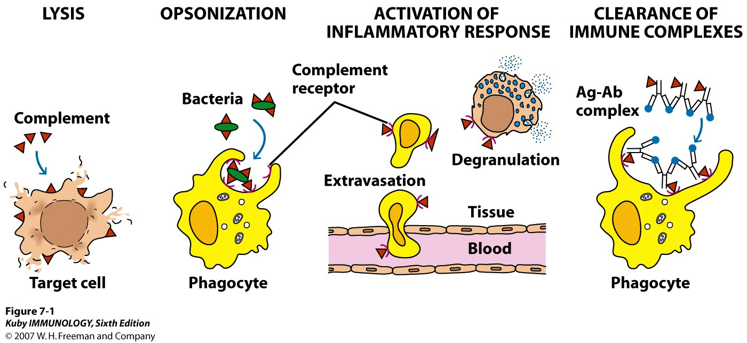

Slide 10
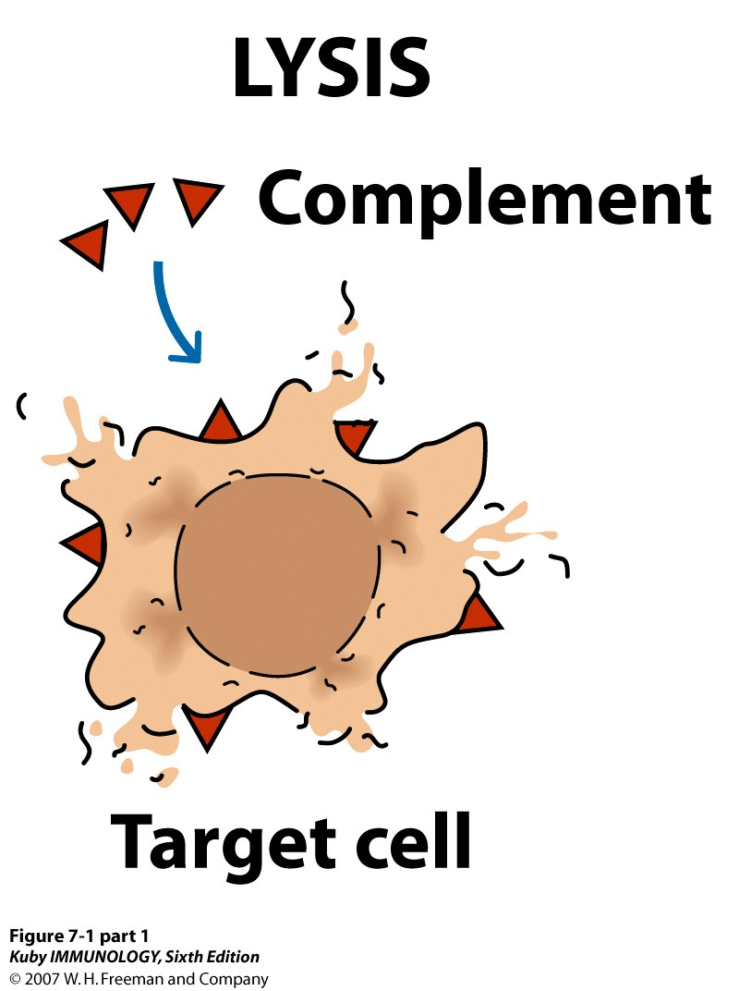

Slide 11
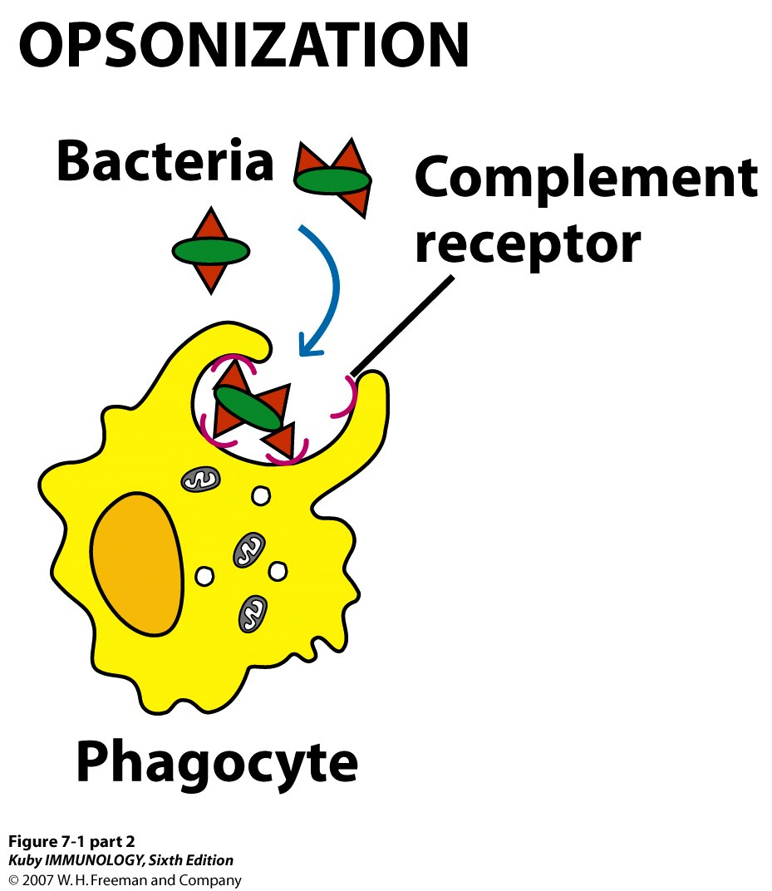

Slide 12
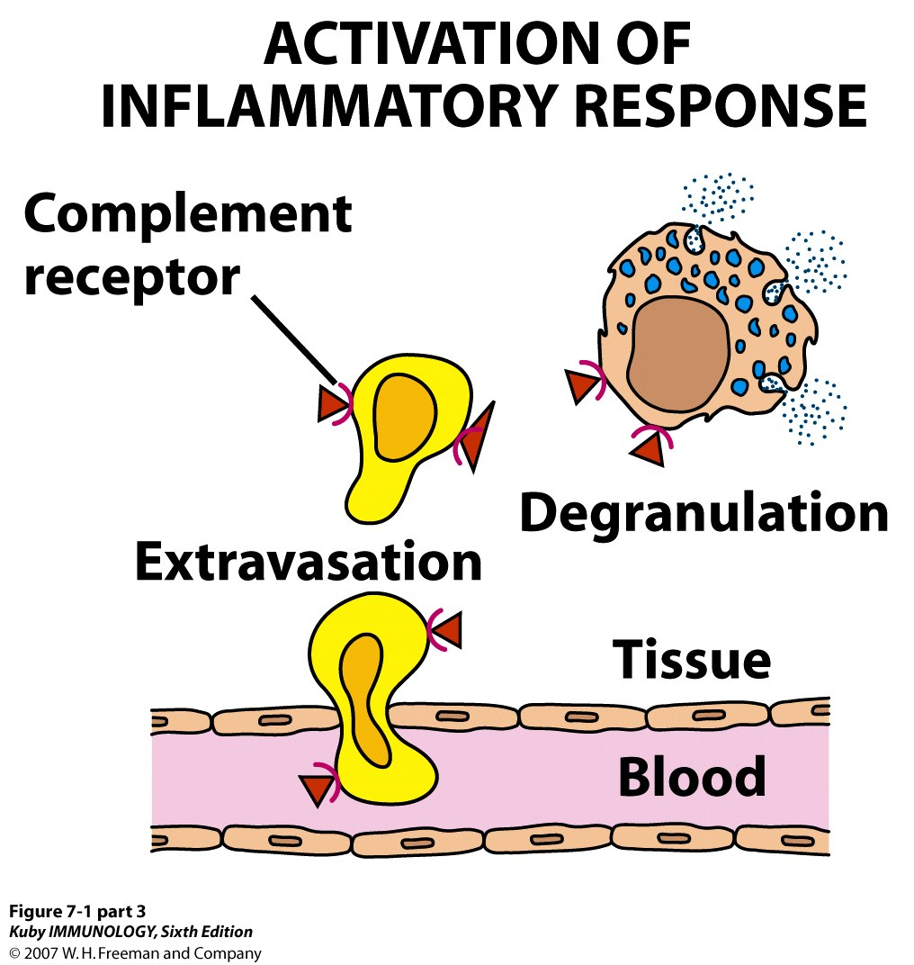

Slide 13
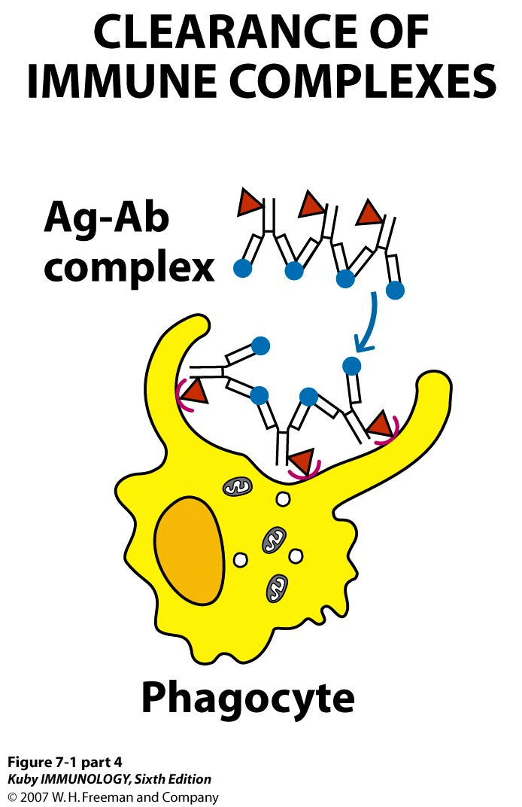

Slide 14
Three pathways: Classical, Alternative, & Lectin
Final steps identical in all 3 pathways
Classical - Initiated by formation of an Ag- Ab
complex
2. Alternative - Antibody-independent
- Part of innate immunity
- Initiated by foreign cell surfaces
3. Lectin - Initiated by host proteins binding
microbial surfaces

Slide 15
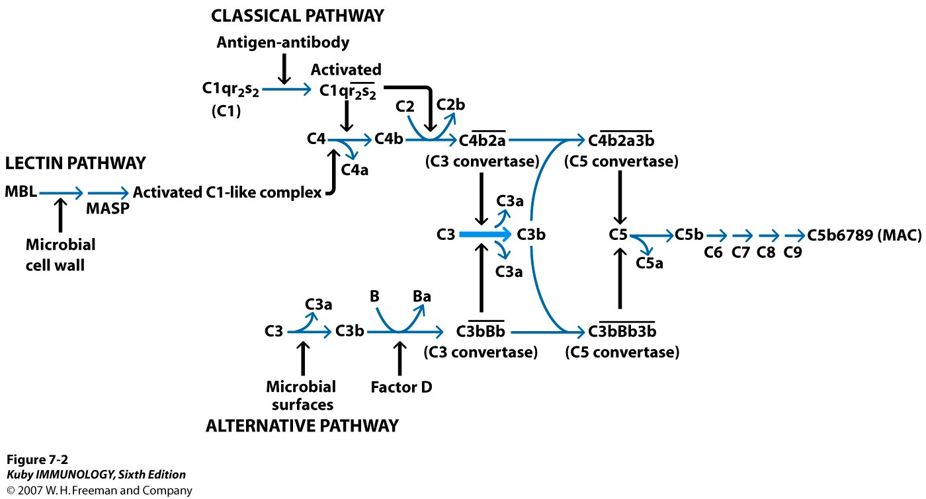

Slide 16
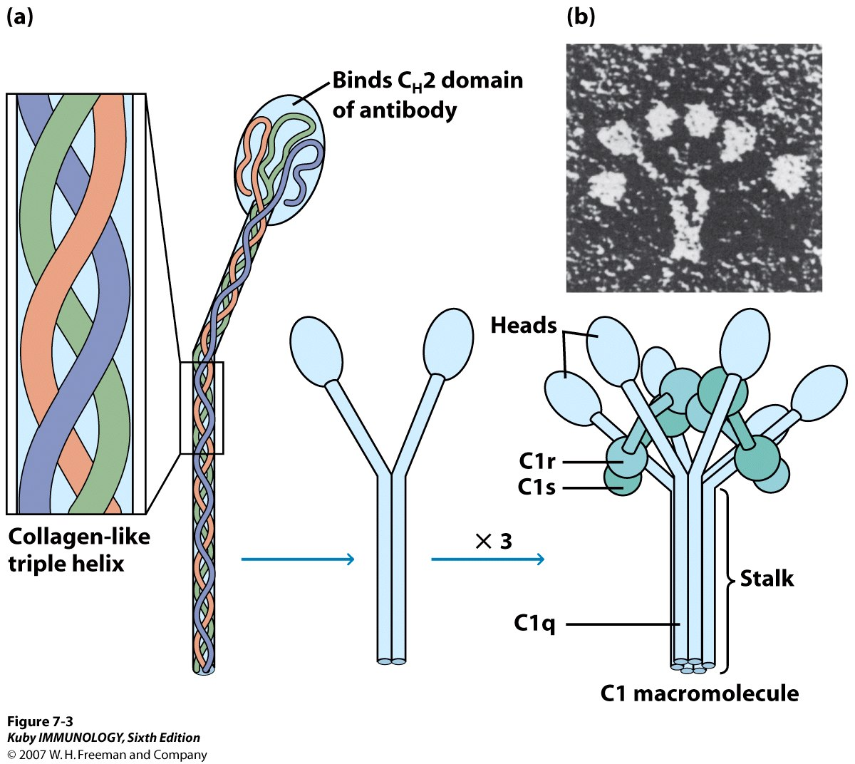

Slide 17
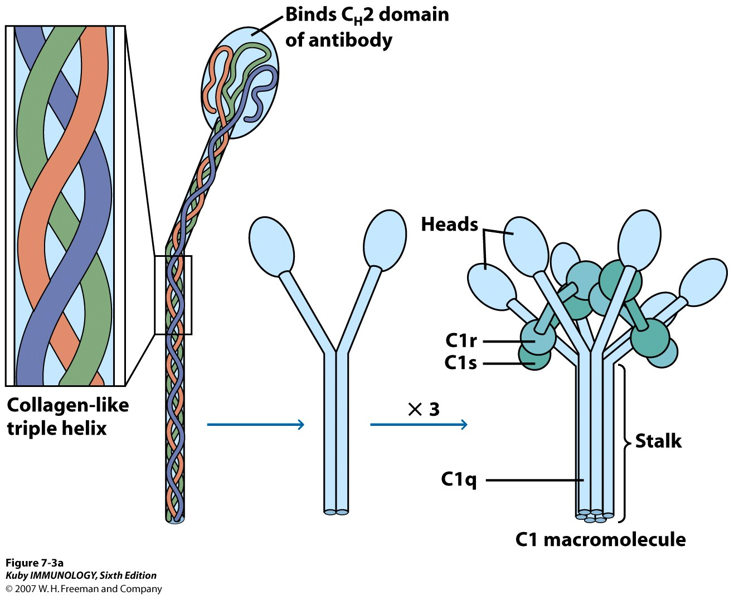

Slide 18
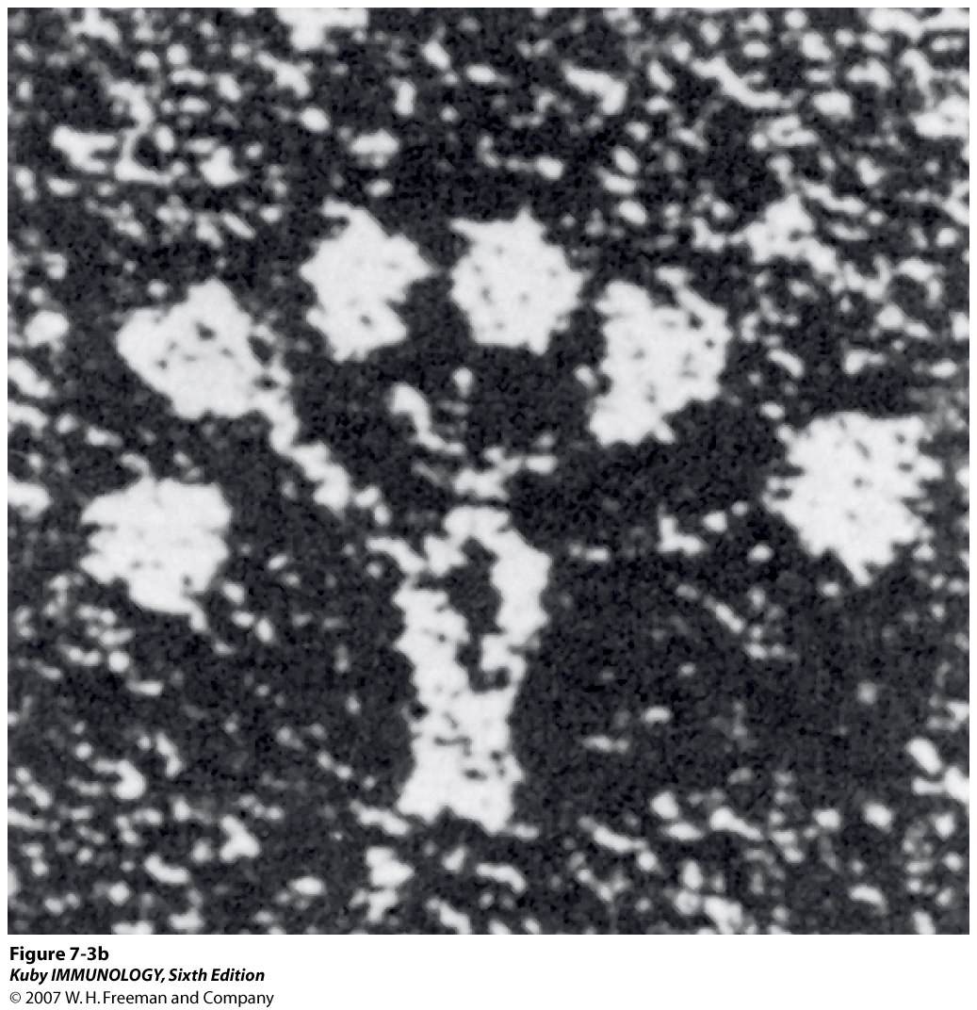

Slide 19
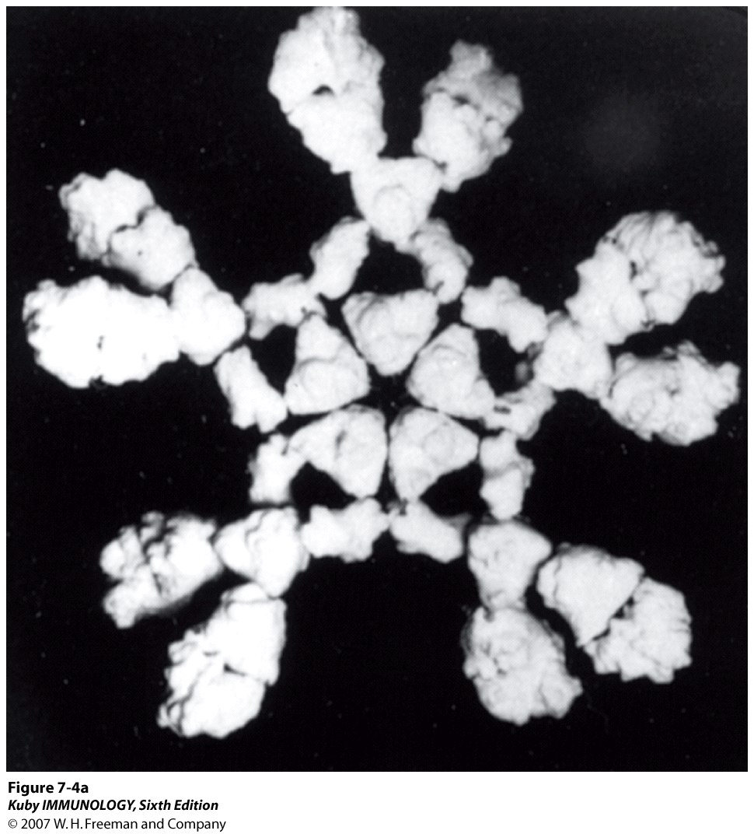

Slide 20
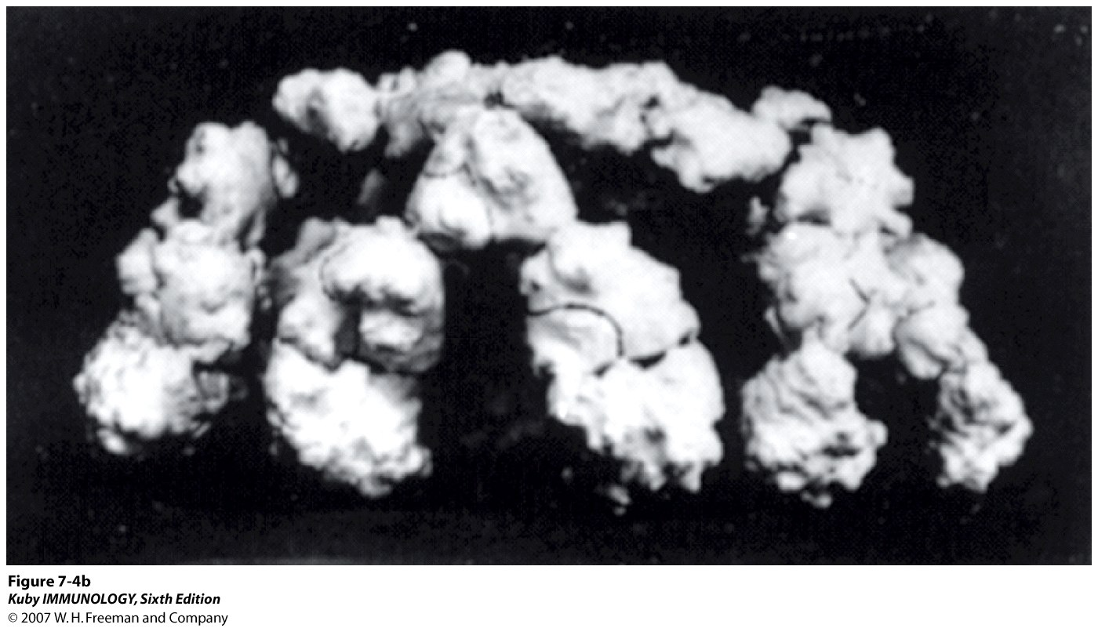

Slide 21
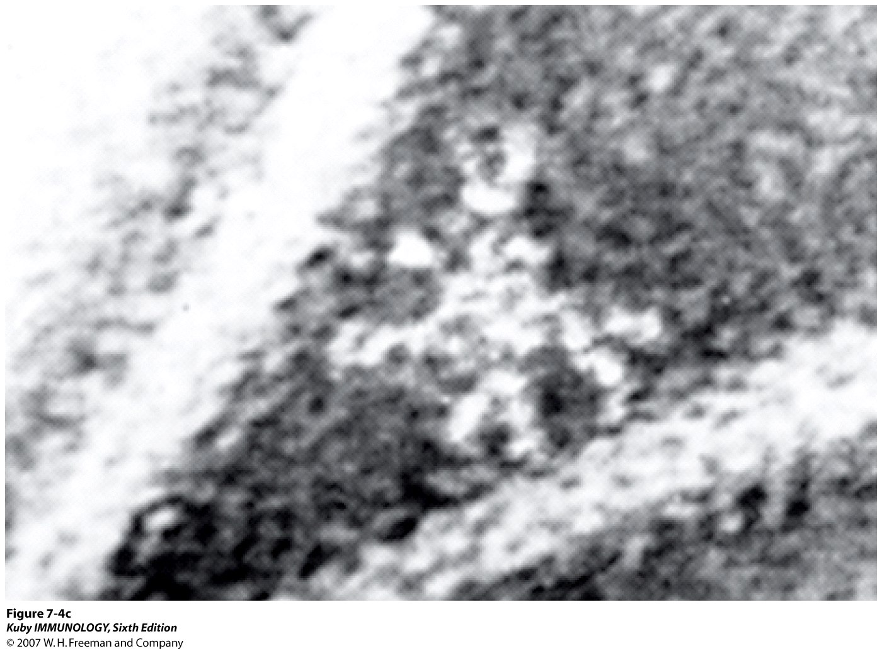

Slide 22
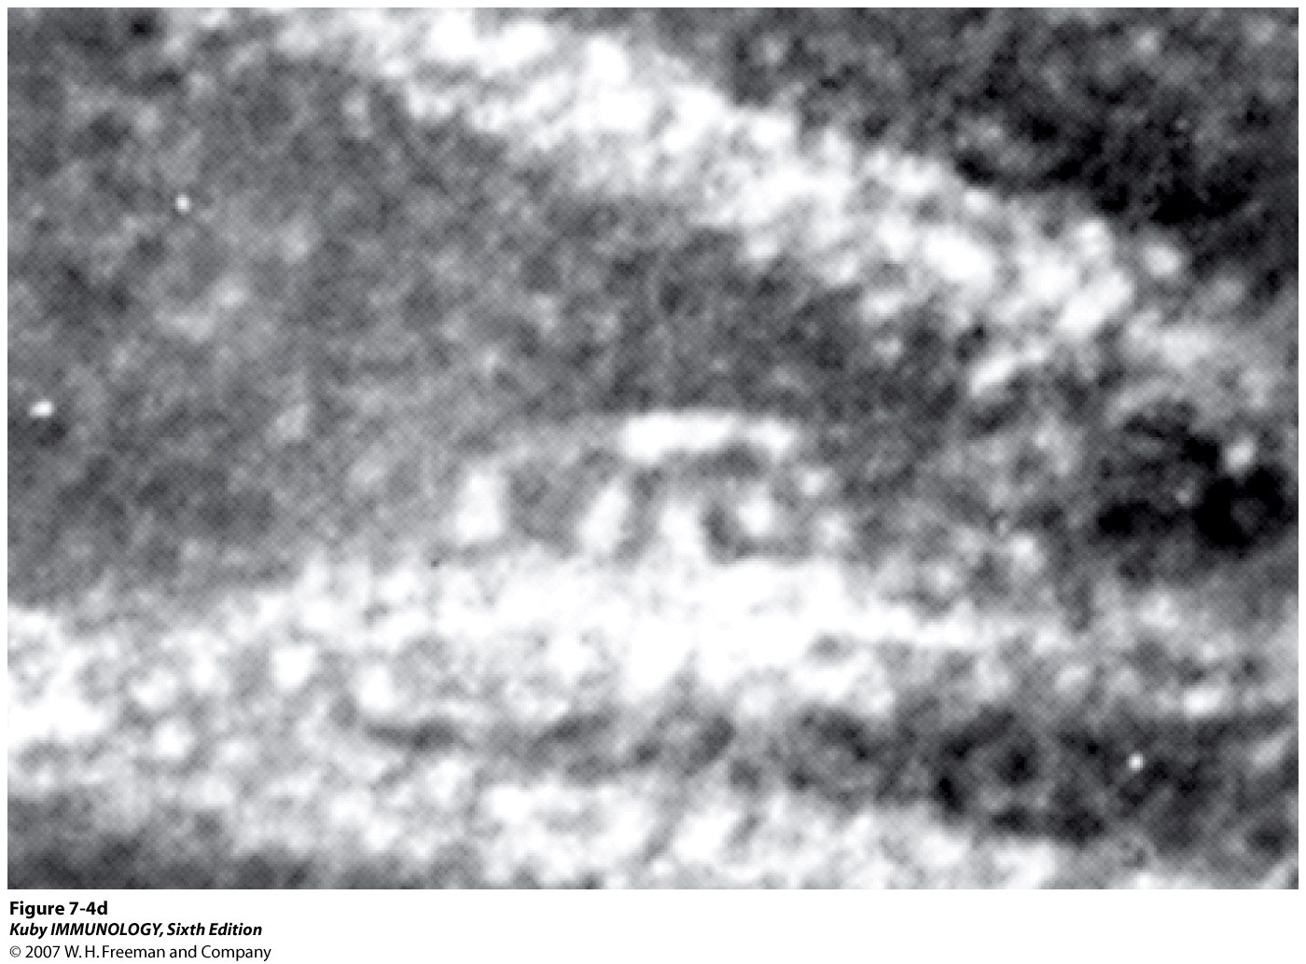

Slide 23
Classical pathway
Classical was discovered first (but actually evolved later)
Initiated by:
-formation of a soluble Ag-Ab complex
-binding of antibody to a target such as
a bacterial cell
Only certain antibodies can initiate this
(IgM, some classes of IgG)

Slide 25
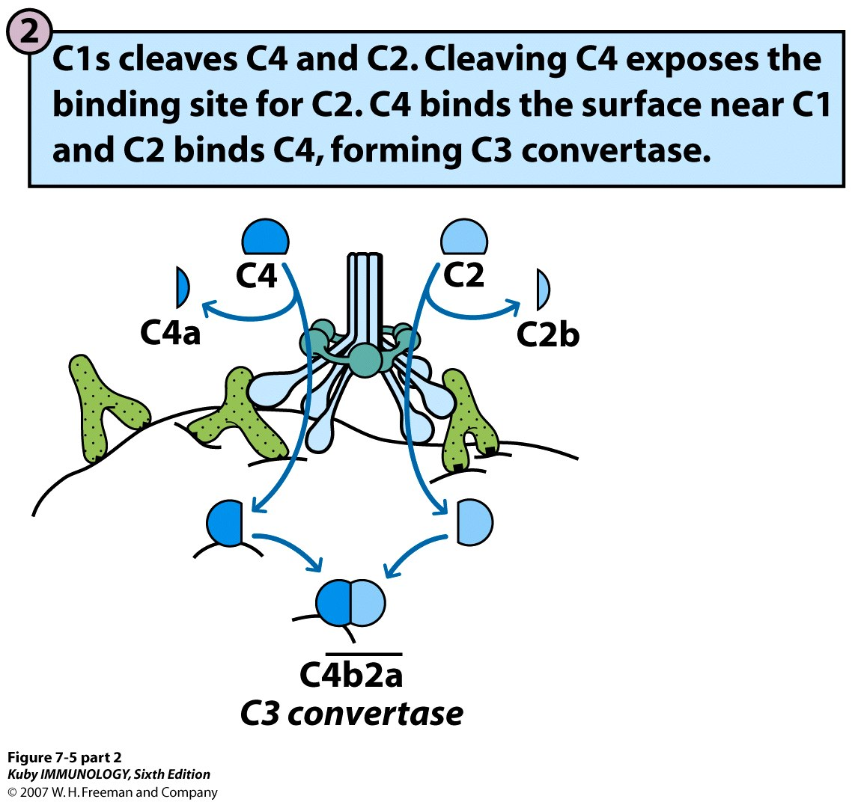

Slide 27
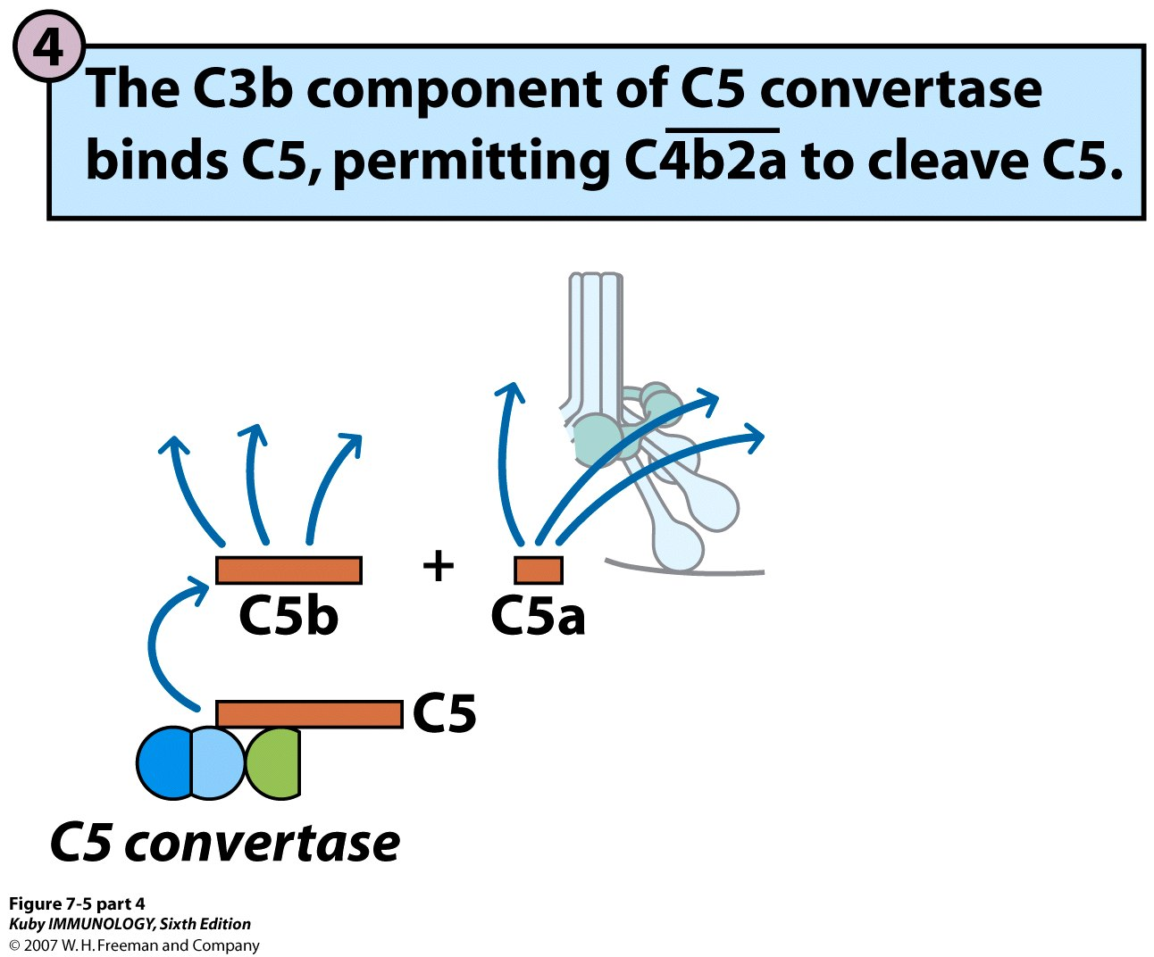

Slide 28
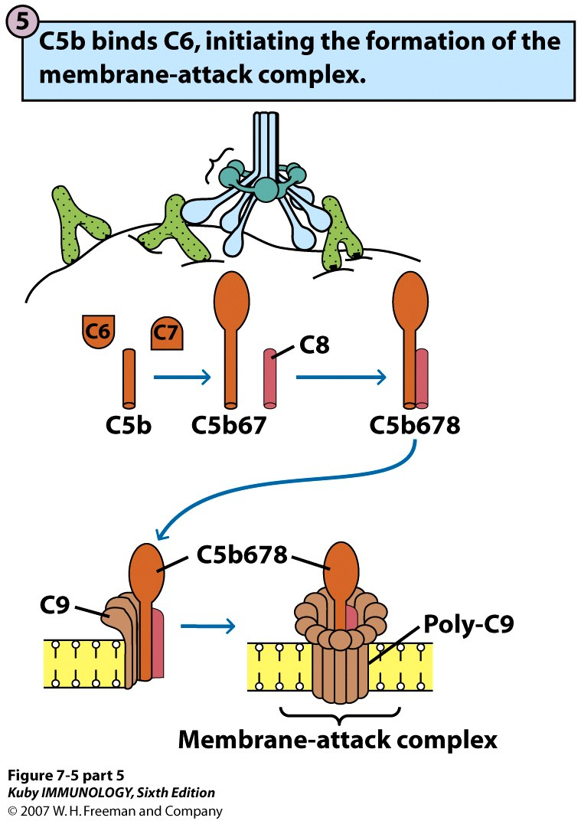

Slide 29
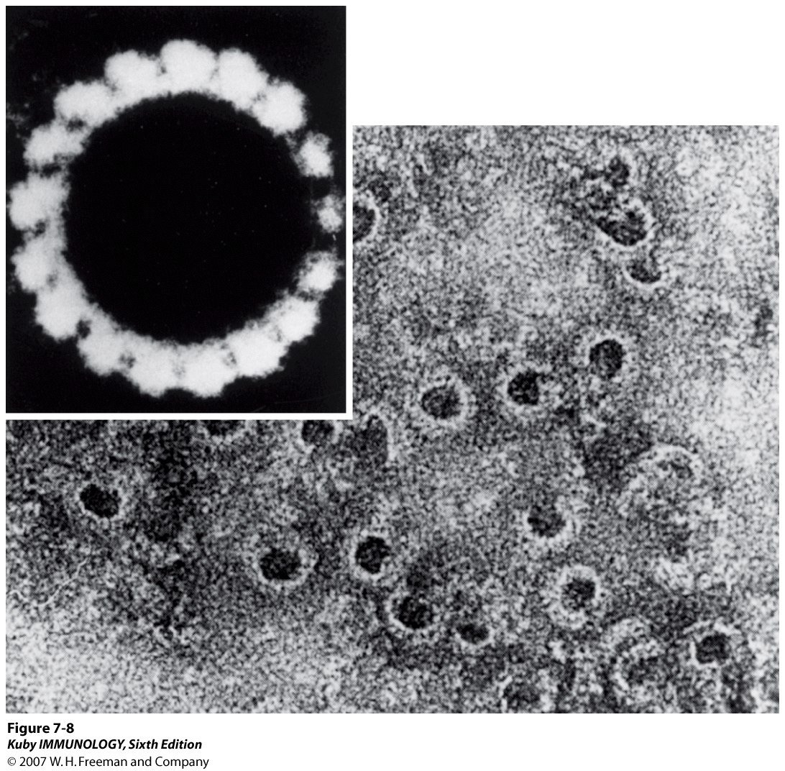

Slide 30
CLASSICAL PATHWAY-

Slide 31
E+A
Ca++
Cl
EA
EAC1
C4
C4a
C4b
EAC14b
Mg++

Slide 32
C2
C2a
It has kinin like activity and increases vascular permeability.
C2b
EAC14b2a
(C3 convertase)
C3
Chemotatic and anaphylatoxic properties
C3a
C3b
EAC14b2a3b
(C5 convertase)

Slide 33
C5
Anaphylatoxic and chemotactic activity
C5a
C5b
C6
C7
C567
Binds to cell membrane and prepares the cells for lysis by C8 and C9.
C8
C9
C14b2a3b5b6789
Cell damage or lysis.

Slide 34
Alternative pathway
Four components: C3, factor B, factor D, properdin
Triggering substances may be pathogens or nonpathogens :
bacterial cell wall components,
fungi, viruses, parasites
immune complexes, RBCs, polymers

Slide 35
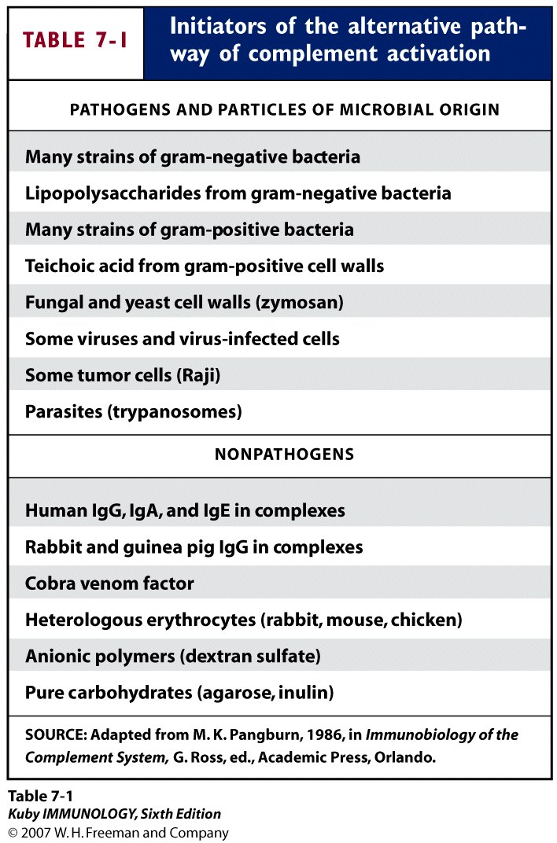

Slide 36
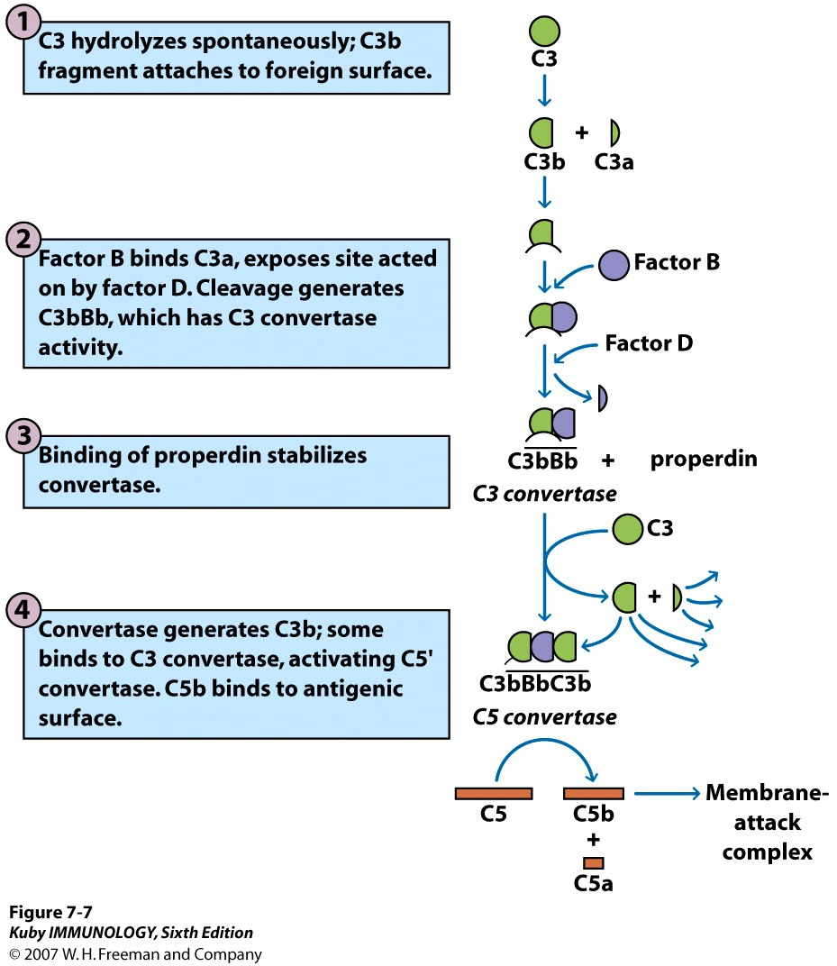

Slide 37
ALTERNATIVE PATHWAY-

Slide 38
C3b in circulation
Free C3b inactivated by factors H and I.
+
Activator e.g. endotoxin
C3b (bound)
Mg++
factor B
C3bB
Ba
factor D
C3bBb
(C3 convertase)

Slide 39
C3
Chemotactic and anaphylatoxic
C3a
C3b
C3bBb3b
(C5 convertase)
C5
C5a
C5b
C6
C7

Slide 40
It also sensitises bystander cells to make them susceptible to lysis.
C567
Binds to cell membrane and prepares the cells for lysis by C8 and C9
C8
C9
C3bBb3b5b6789
Cell damage or lysis.

Slide 42
Lectin pathway
Lectin is a protein that binds to carbohydrate
MBL (mannose-binding lectin) binds to
mannose on many bacterial cells
- MBL is produced by liver in acute-phase
inflammatory reactions
Once MBL binds to target cell, 2 serine
proteases (MASP-1, MASP-2) bind
Acts like C1

Slide 43
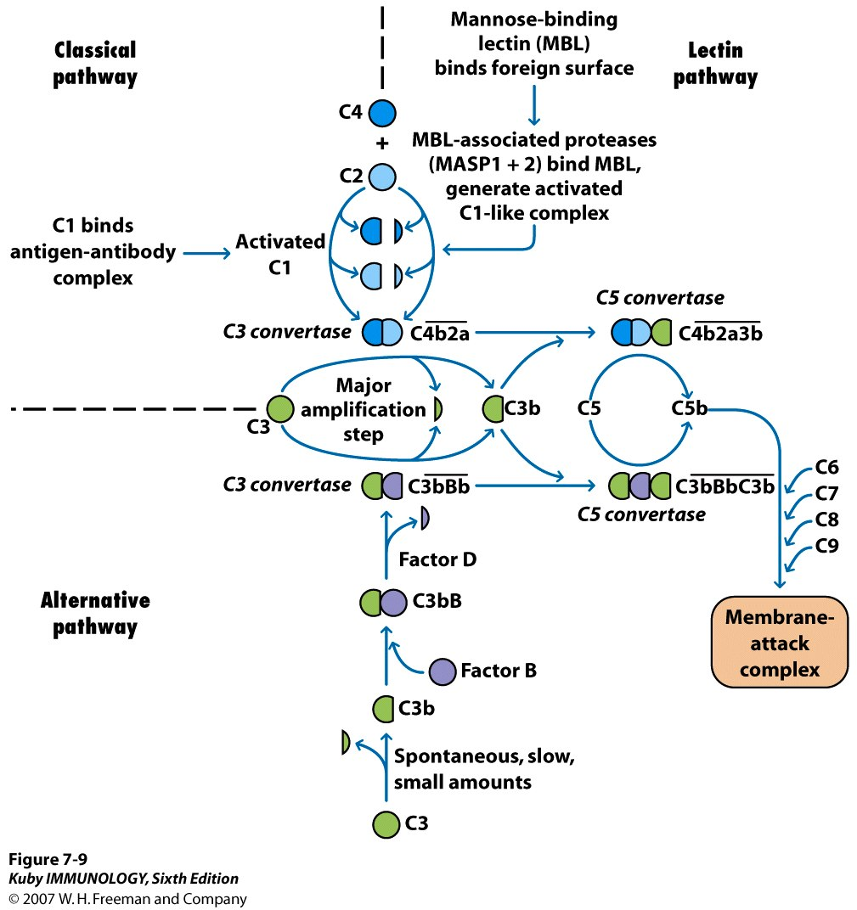

Slide 45
The Complement Cascade
The Alternative Pathway
C3
P
C3a
Ba
Properidin
B
C3b
C3bB
C3bBb
C3bBbP
C3bBb3b
C5a
D
C3a
B
C5
C3iBb
C3iB
C3i
C3
Ba
The Tick-over Activation
C3
The Classical Pathway
C5b
Antibody + C1qrs
C4
C4b
C4b2a
C4b2a3b
C2
C2b
C3
C3a
C4a

Slide 46
Regulation of complement system
Because it is nonspecific, several regulatory mechanisms are involved (otherwise there would be a lot of “collateral damage”)
Many components are very labile
Many regulatory proteins block activity through binding to target

Slide 47
REGULATON OF COMPLEMENT ACTIVATOR
[A] INHIBITOR
(1). C1 ESTERASE
* INHIBIT CLR,CLS BY BINDING TO ACTIVE SITE.
*MURAMINOGLYCOPROTEIN
*HEAT LABILE
*PREVENTS NORMAL CASCADE
*CHECKS AUTOCATALYTIC PROLONGATION

Slide 48
REGULATON OF COMPLEMENT ACTIVATOR
(2).S PROTIEN
*BINDS TO C567
*MODULATES CYTOLYTIC ACTION OF MEMBRANE ATTATCH COMPLEX
[B] INACTIVATOR
(1) Fac1
*SERUM BETA GLOBULIN
*C3B,C4B ARE CLEAVED & IN ACTIVATED

Slide 49
REGULATON OF COMPLEMENT ACTIVATOR
*HOMEOSTATIC CONTROL OF C3 ACTIVATION.
*ENDOPEPTIDASE WHICH CLEAVES C3b & C4b.
(2) FACTOR H
*REGULATES ALTERNATIVE PATH WAY BY PREVENTION FACTOR B TO BOUND TO C3
*BETA GLOBULIN FACTOR
*ACTS ALONG WITH FACTOR 1 MODULATIG C3 ACTIVATION.

Slide 50
REGULATON OF COMPLEMENT ACTIVATOR
(3) ANAPHYLATOXIN INACTIVATORS
*ENZYMATICALLY DEGRADES C3a,C4a,C5a
(4) C4 BINDING PROTEIN
*CONTROLS ACTIVITY OF ALL BOUND C4b
*BINDS TIGHTLY TO C4b & ENHANCES C4b DEGRADATION.

Slide 51
REGULATION OF COMPLEMENT ACTIVATOR
(5) FACTOR P OR PROPERDIN
*BINDS TO A STABILIZER THE ALTERNATIVE PATH WAY C3 CONVERTASE
*ACTIVATED PROPERDIN BINDS DIRECTLY TO BOUND & UNBOUND C3b
*STABILIZE C3 & C5 CONVERTASE

Slide 52
REGULATION OF COMPLEMENT ACTIVATOR
*INDUCE FURTHER ACTIVATION OF COMPLIMENT
COMPONENT INDIRECTLY BY EXTENDING THE
HALF LIFE OF C3bBb
(6)COBRA VENOM FACTOR (COVF)
*PROTEIN FOUND IN COBRA VENOM ACTIVATES COMPLEMENT & LYSES ERYTHROCYTES

Slide 53
REGULATION OF COMPLEMENT ACTIVATOR
*CAN COMBINE TO FACTOR B TO FORM COVF-Bb
COMPLEX i.e. EQUIVALENT TO C5 CONVERTASE
*VENOM IS RESISTANT TO ACTION OF
INACTIVATORS OF ALTERNATIVE PATH WAY
FACTOR H & I

Slide 54
BIOLOGICAL EFFECTS OF COMPLEMENT SYSTEM
(1) INFLAMMATORY RESPONSE : C3a & C5a
*ANAPHYLATOXINS
*RELEASES HISTAMINE & OTHER MEDIATOR BY DEGRANULATION OF MAST CELLS
*CHEMOTATICE-C567
*INCREASE VASCULAR PERMEABILITY,CONTRACTION OF SMOOTH MUSCLE,VASODILATION,COLLECTION OF INFLAMATORY CELLS,INCREASE IN PHAGOCYTIC ACTIVITY

Slide 55
BIOLOGICAL EFFECTS OF COMPLEMENT SYSTEM
(2)HYPER SENSITIVITY:TYPE II & TYPE III
(3) ENDOTOXIC SHOCK:
ALTERNATIVE PATH WAY,EXCESSIVE C3 ACTIVATION,PLATELET ADERENCE
(4) COAGULATION C3
*LYSES PROTHROMBIN
*THROMBIN RELEASES LARGE AMOUNT OF PLATELET FACTOR

Slide 56
BIOLOGICAL EFFECTS OF COMPLEMENT SYSTEM
DISSEMINATED INTRAVASCULOR COAGULATION & THROMBOCYTOPENIA
(5) IMMUNE ADHERENCE :
*C3 & C4
*ANTIGEN ANTIBODY COMPLEXES + C
ADHERE TO ERYTHROCYTES OR PLATELETS
ENHANCED PHAGOCYTOSIS
*PHAGOCYTIC CELLS HAVE RECEPTORS FOR C3b

Slide 57
BIOLOGICAL EFFECTS OF COMPLEMENT SYSTEM
(6) OPSONIZATION : CR1,CR2,CR9,CR4,CCq ON MACROPHGES,NEUTROPHILL,MONOCYTES ETC.CR2 PRESENT OF B CELL
(7) AUTO IMMUNE DISEASES
E.G.-SLE & ANGIONEUROTIC OEDEMA
-DUE TO DEFICIENCY OF DOME COMPLEMENT FACTORS

Slide 58
BIOLOGICAL EFFECTS OF COMPLEMENT SYSTEM
(8) SUSCEPTIBILITY
GRAM NEGATIVE BACTERIA – LYSIS
GRAM POSITIVE BACTERIA- WITHOUT LYSIS
(9) C3 & C6 PARTICIPATE IN COAGULATION PROCESS

Slide 59
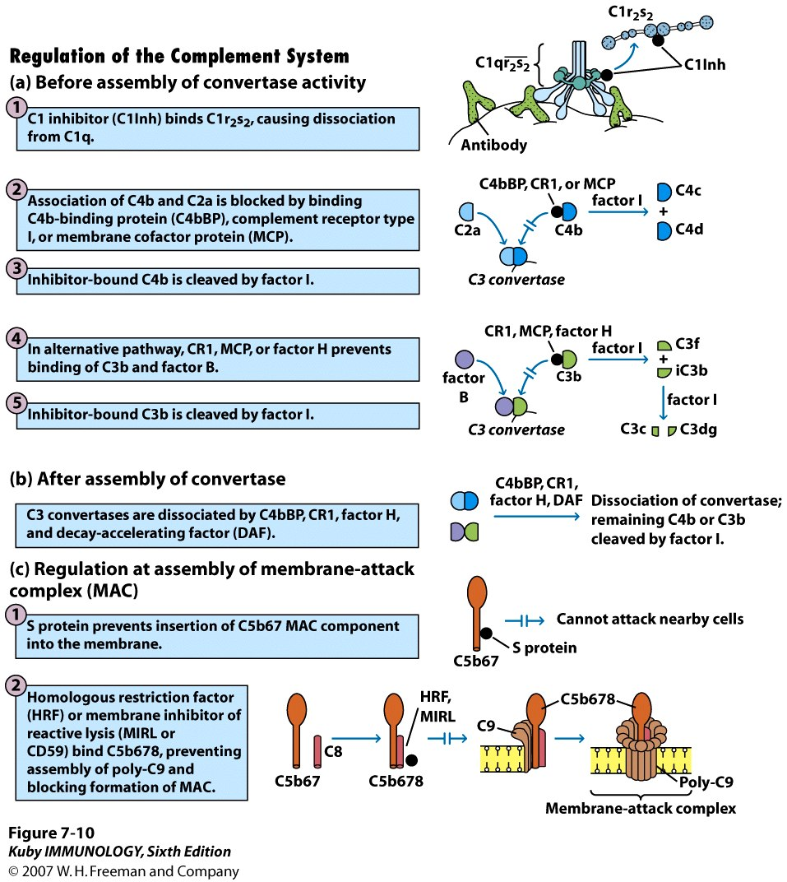

Slide 60
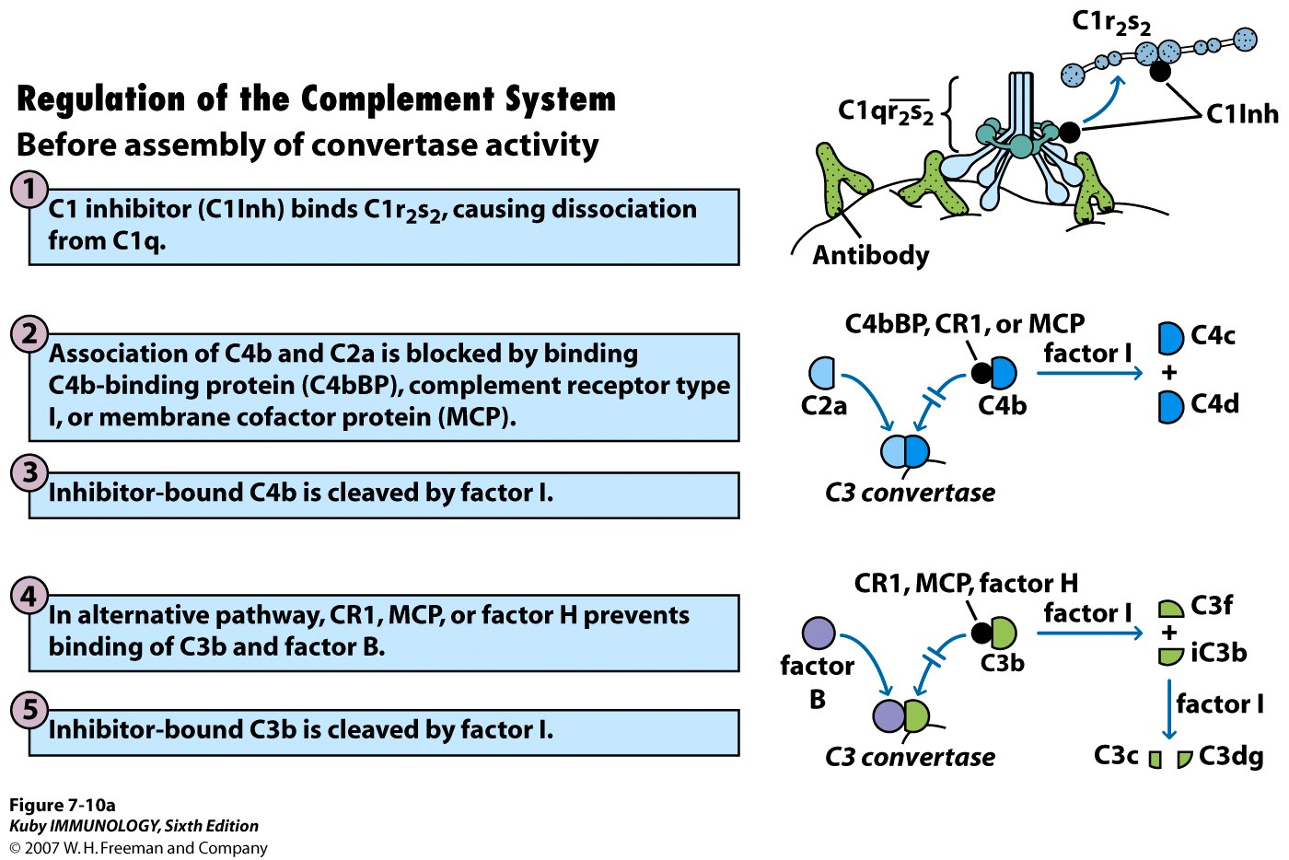

Slide 62
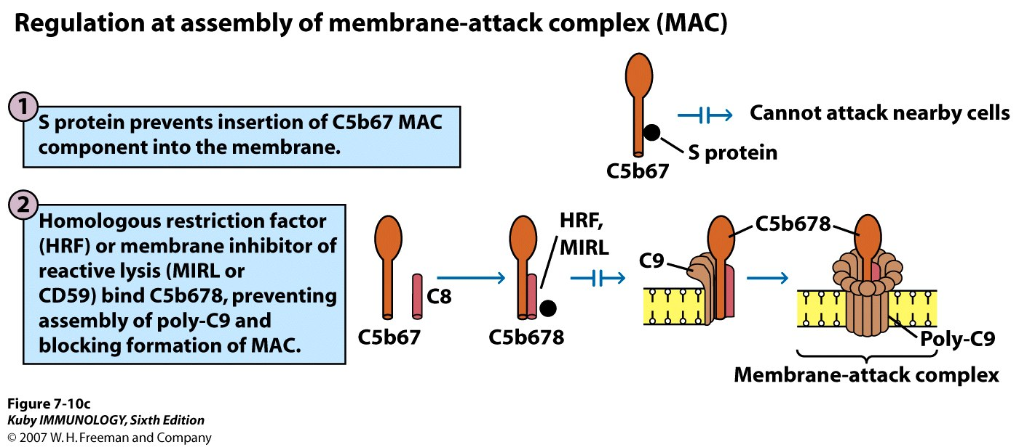

Slide 63
Regulation of the Complement Cascade
Short half-time of
C3b
C3bBb
C5b
C1 inhibitor
Inhibits the C1s activity
Protein S in Serum
Binds to C5b67
Inhibits Formation of the Membrane Attack Complex

Slide 64
HRF or CD59
Bind to C8
Inhibits C9 binding
Factor H
Binds to C3b
Facilitates binding of Factor I
cleaves C3b to inactive iC3b
cleaves C4b to inactive fragments
Decay Accelerating Factor
Increased dissociation of C3 convertase (both pathways

Slide 65
Complement Activation
General
Hydrophobic surfaces
Oxides
Strong binding of C3(b) to nucleophilic groups (-NH2, -OH)
Higher absorption of C3 to crystalline TiO₂ than to amorphous
Kallikrein directly activates C5
Plasmin directly activates C5

Slide 66
Classical Pathway
Antibodies IgM, IgG1, IgG2, IgG3
Lectin via the mannan binding protein (MBP) “Lectin Pathway”
Hageman Factor (F XIIa)
Rough surfaces
C-reactive protein (CRP)
(Zirkonium, transiently)

Slide 67
Alternative Pathway
PE debris
Acetylated chilosan

Slide 68
Biological effects of complement activation
Complement fragments must bind to
complement receptors expressed by various cells

Slide 69
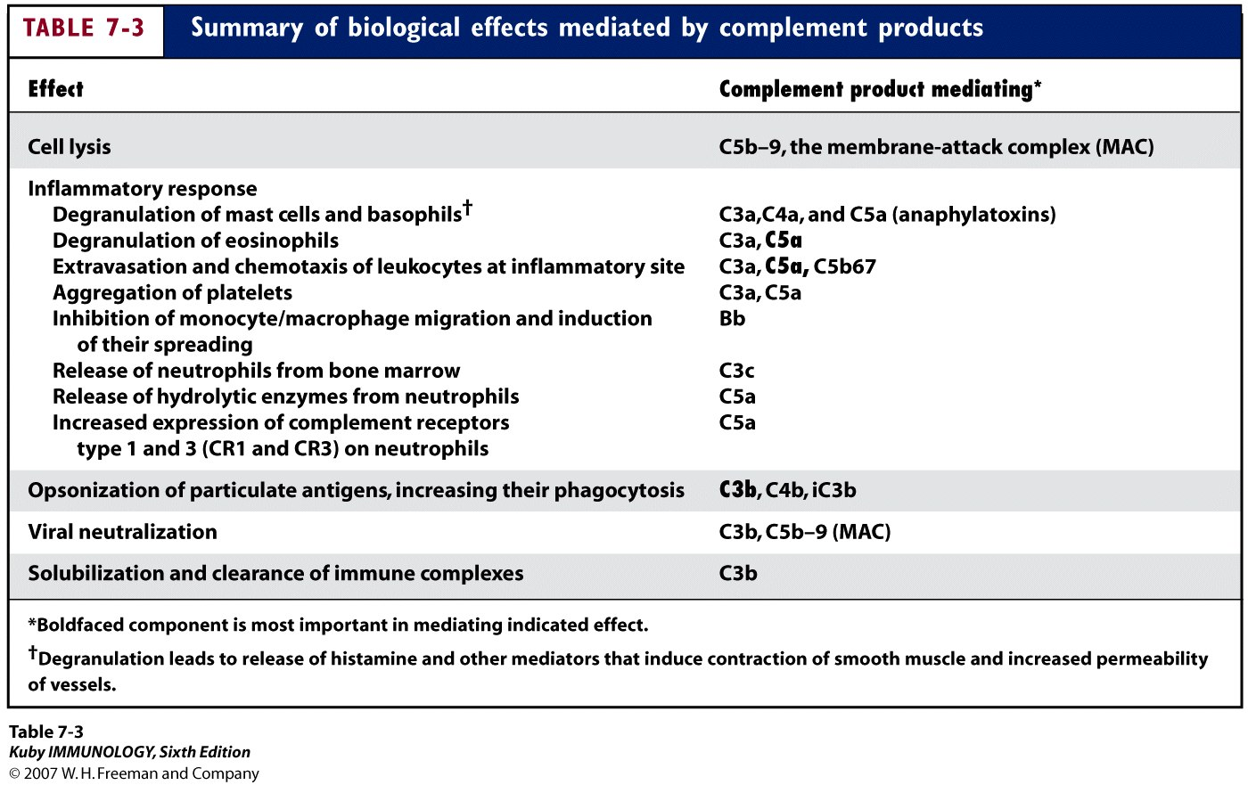

Slide 70
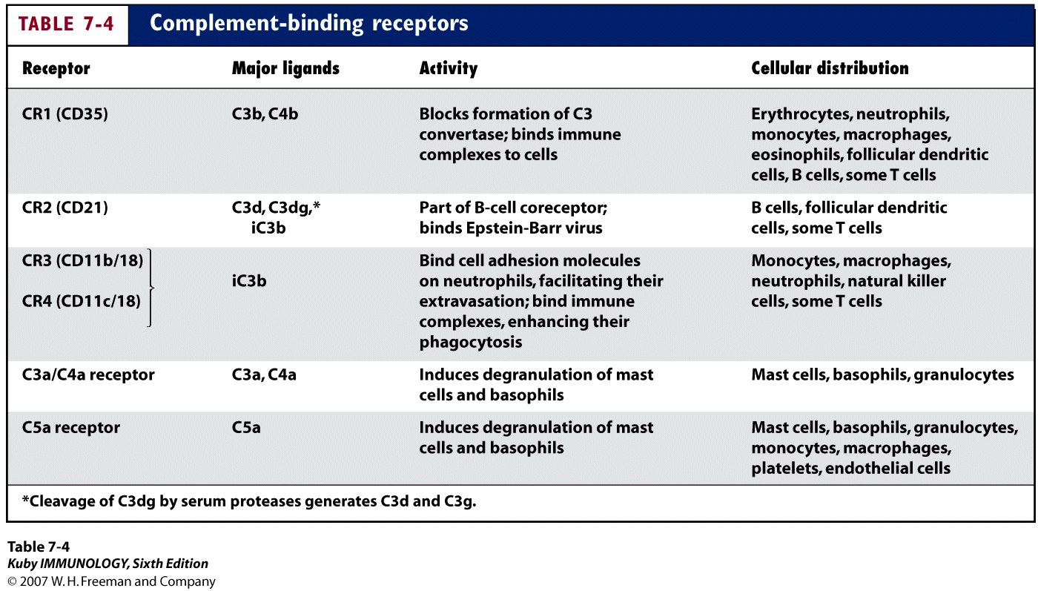

Slide 71
Anaphylatoxins
Fragments C5a, C3a, C4a
Degranulation of Phagocytes
Reactive oxygen species
Prostaglandins
Monocytes → IL-1, IL-6
Mast cells → Histamine
Chemotaxis
Only C5a

Slide 72
Consequences in vitro
Lysis of “innocent” neighbour cells
Red blood cells
Activation of phagocytic cells
Release of reactive oxygen species
Release of mediators

Slide 73
Consequences in vivo
Factors of complement activation at revised hip implants
One single study (Tang L. et al. J Biomed Mater Res 41: 333-340 (1998))
Au-Mercaptoglycerol induces strong inflammatory response in control animals.
No reaction in Complement-depleted animals.

Slide 74
Amplifies humoral response
Destroys invading bacteria and viruses
(lysis by MAC)
Inflammatory response
Opsonization of antigen (enhances
phagocytosis)
Virus neutralization
Clearance of immune complexes

Slide 75
Some bacteria can resist lysis
Gram-positive bacteria
Some microbes produce inactivating enzymes
Nucleated cells are harder to lyse
Not particularly effective against tumor cells (they can endocytose MAC and
repair damage)

Slide 76
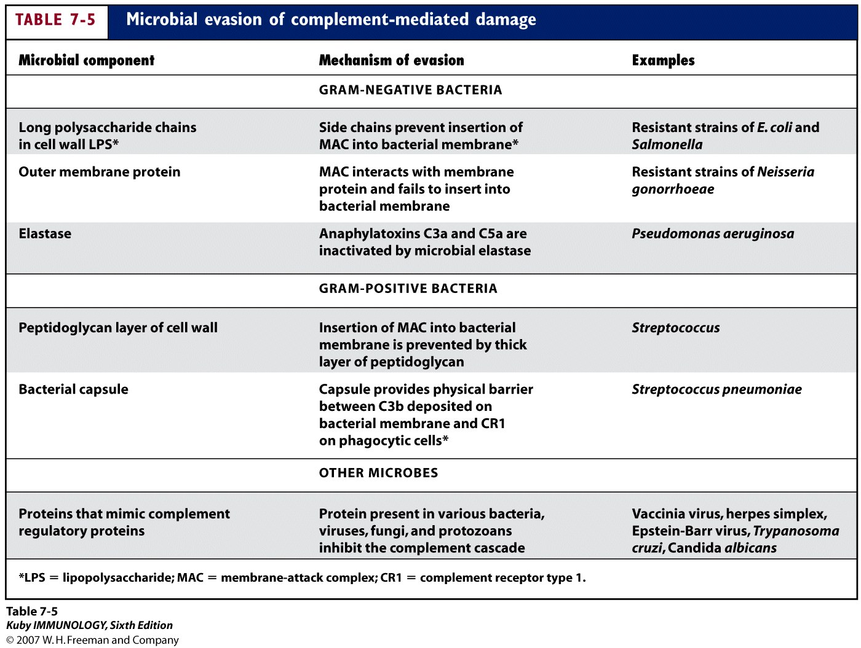

Slide 77
Inflammation
many of the released fragments help
develop an inflammatory response
C3a, C4a, C5a- anaphylotoxins
bind to receptors on mast cells and
basophils; degranulation
(smooth muscle contraction; capillary
dilation; fluid influx)
also play a role in blood cell chemotaxis

Slide 78
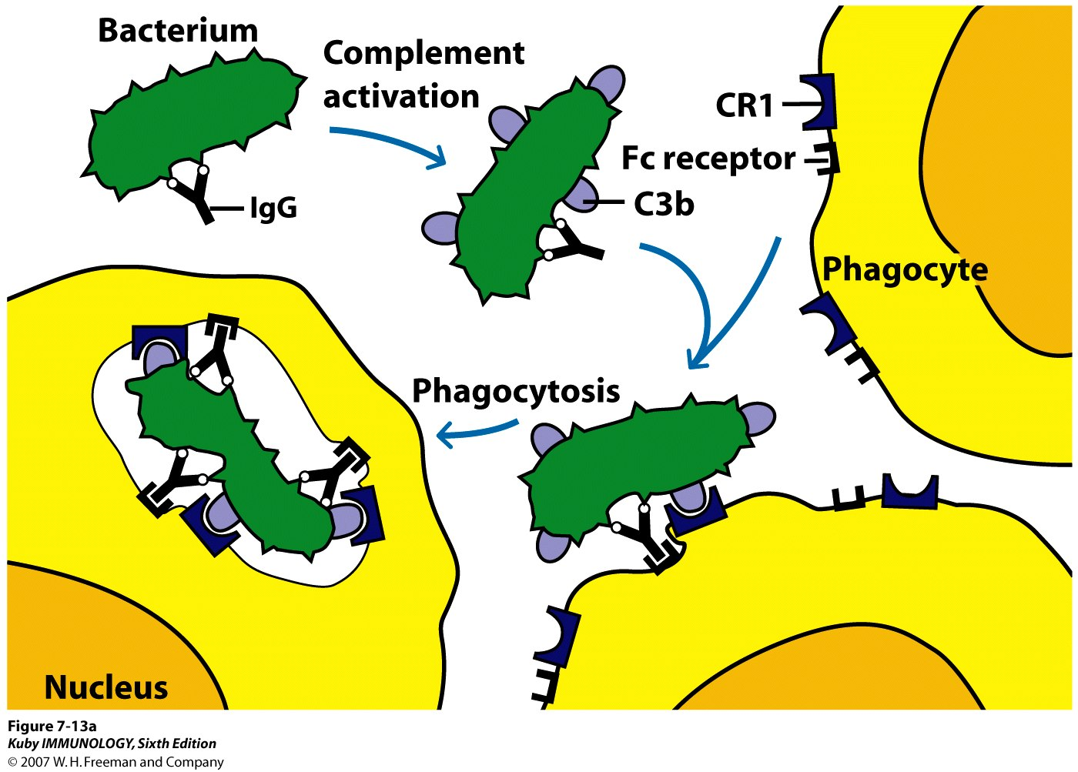

Slide 79
Viral neutralization
Some viruses activate alternative or lectin
pathway
Antibody-mediated (classical) pathway is
more common
Causes aggregation of viruses; can’t infect
host cells; more vulnerable to phagocytes
Enveloped viruses can be lysed

Slide 80
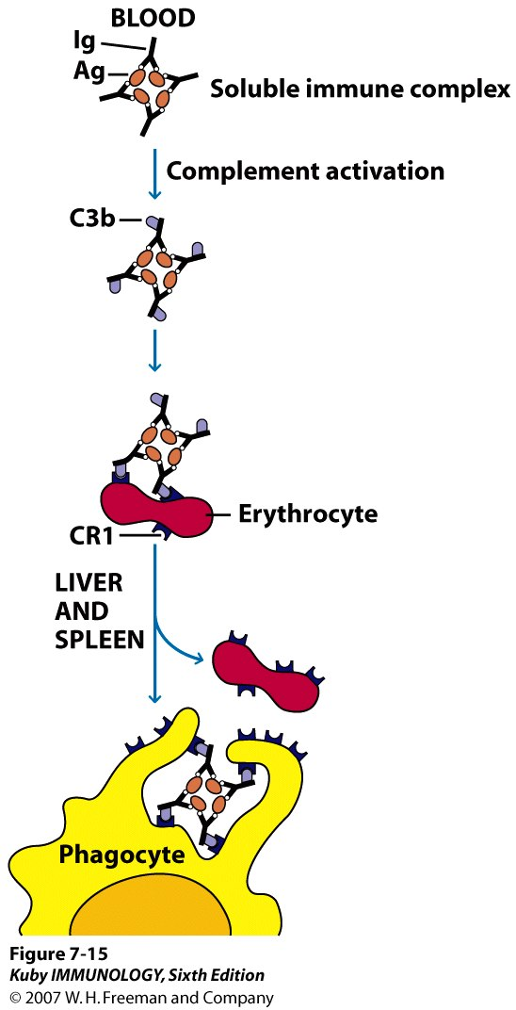

Slide 81
Consequences of complement deficiency
Early components of classical pathway (C1,
C4, C2)- immune complex disease
can’t generate C3b, which is needed
for solubilization
Recurrent Staph and Strep infections
(can’t lyse bacteria but seem to control
infections)
Early components of alternative pathway-
not as serious; tendency to infections
by Neisseria

Slide 82
C3 deficiencies (can’t activate C5 and form MAC)
Recurrent severe bacterial infections
MAC deficiencies- recurrent Neisseria infections
Regulatory protein deficiencies
1.edema
2.RBC lysis

Slide 83
Methods for Investigation
General/Common pathway
Lysis of sheep red blood cells
Solid phase methods (ELISA, RIA)
Products: C3a, C5a, sC5b-9
Consumption of C3
Ellipsometry
Classical Pathway
Measurement of C1qrs
Measurement of C2b or C4b2a
Alternative Pathway
Measurement of Ba or C3bBb
Measurement of Properidin

Slide 84
 | CLASSICAL | ALTERNATIVE | LECTIN
ACTIVATING SUBS. | IMMUNE COMPLEXES (IgG OR IgM) | LPS (bacterial capsule) IgA | Mannose groups on microbial cell
RECOGNITION UNIT | C1q, C1r, C1s | C3, Factor B, Factor D | MBP, MASP-1, MASP-2
C3 CONVERTASE | C4b2a | C3bBb | C4b2a
C5 CONVERTASE | C4b2a3b | C3bBb3b | C4b2a3b
MAC |  | C5b6789
END RESULT | CELL LYSIS

Slide 88
Summary
The complement system comprises a group
of serum proteins which, when activated,
plays an important role in antigen
clearance.
The classical, alternative and lectin pathways
have been described.
Elaborate regulatory mechanisms are required
to prevent damage to normal cells.

Slide 89
TAKE HOME MESSEGE/ FOR THE TOPIC COVERED (SUMMARY)
Complement – Effect, Pathways, Regulation
Application of Complement Syatem

Slide 90
REFERENCES
Microbiology – Prescott, et al.
Microbiology – Bernard D. Davis, et al.
Clinical & Pathogenic Microbiology – Barbara J Howard, et al.
Immunology an Introduction – Tizard.
Immunology 3rd edition – Evan Roitt, et al.
Medical Microbiology – Greenwood
Textbook of Microbiology – Ananthnarayan
The short Text Book of Microbiology – Satish Gupte

Slide 91
Question & Answer Session
Students should be given opportunity to ask question for clarifying for their understand/ confusions. Teachers must spend 5-10 minutes for this to improve the output.

Slide 92
THANK YOU

